Slide 1
Robotics Project Presentation
Fast Direct Stereo Visual SLAM
IEEE Robotics and Automation Letters 2022
Group 5
Rahul Sehgal | 2020232
Siddhant Agarwal | 2020247
Akanksha Singal | 2021008
Kartik Singhal | 2021259
Sparsh Mehrotra | 2020248

Slide 2
SLAM
What is SLAM?
The Simultaneous Localisation and Mapping (SLAM) problem asks if it is possible for a mobile robot to be placed at an unknown location in an unknown environment and for the robot to incrementally build a consistent map of this environment while simultaneously determining its location within this map. A solution to the SLAM problem has been seen as a ‘holy grail’ for the mobile robotics community as it would provide the means to make a robot truly autonomous.

Slide 3
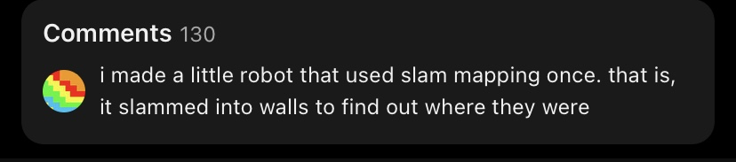
SLAM
Now, one naive way to do this…

Slide 4

SLAM
We can do a little better…
We (autonomous vehicles) have better sources of data through sensors such as LIDAR, Cameras, IMU etc.
This helps us map the world around us as we move through it.

Slide 5
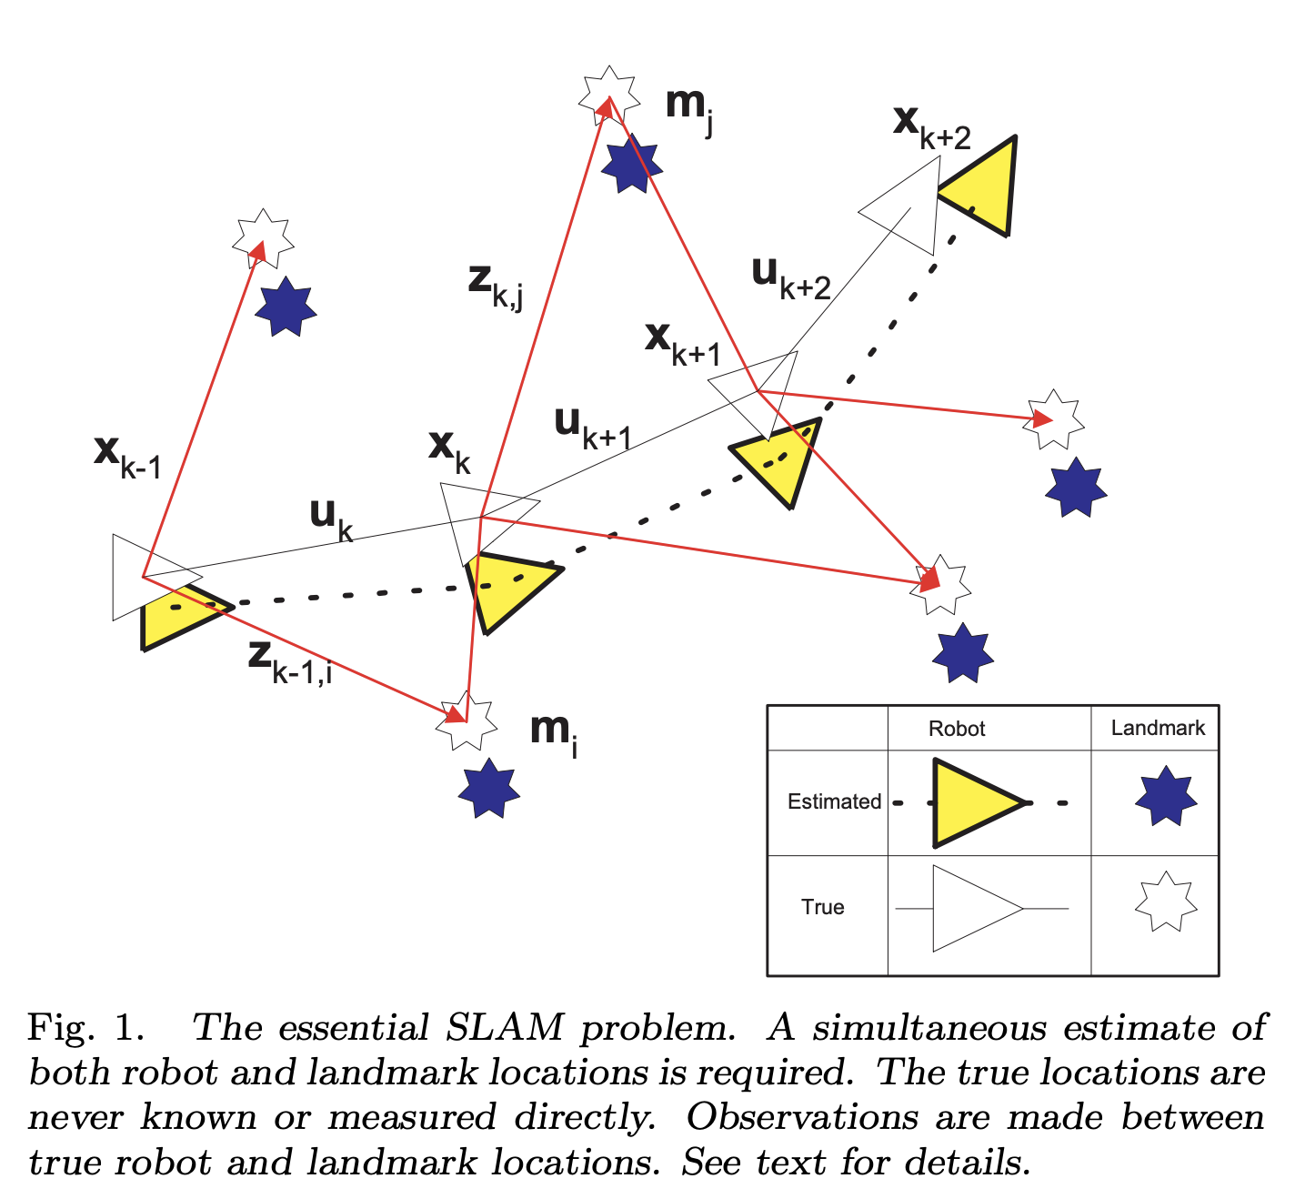
SLAM
If we could find what we see (for example with LIDAR or Cameras) and how we move with 100% accuracy relate the two then this would be a solved problem
But these sensors are not always accurate…
There may be due to the inaccuracy of the sensors, or due to skidding in wheels or due to multitude of other reasons.

Slide 6
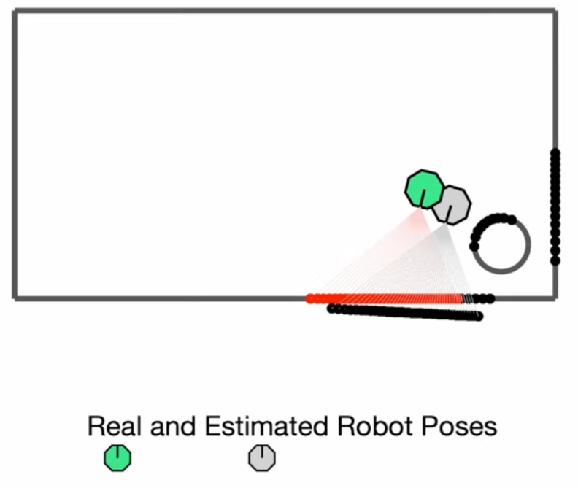
SLAM
That’s where we get to Graph-Based Methods such as using Pose Graph
What is Pose?
Description of Position
And Orientation

Slide 7
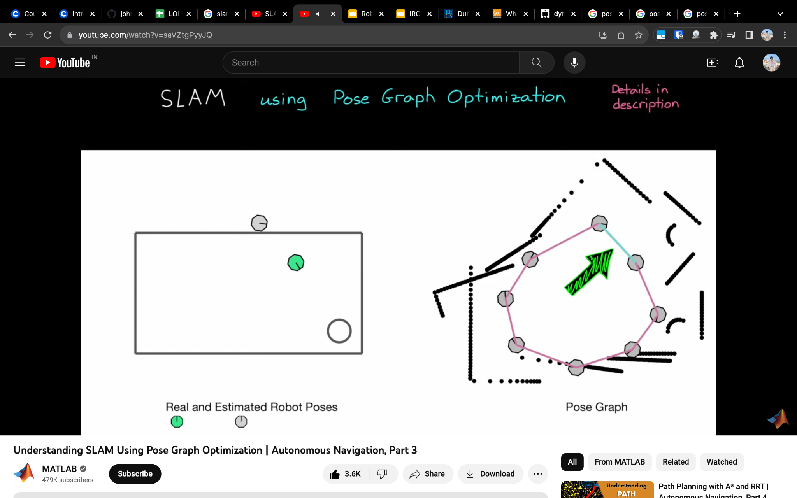
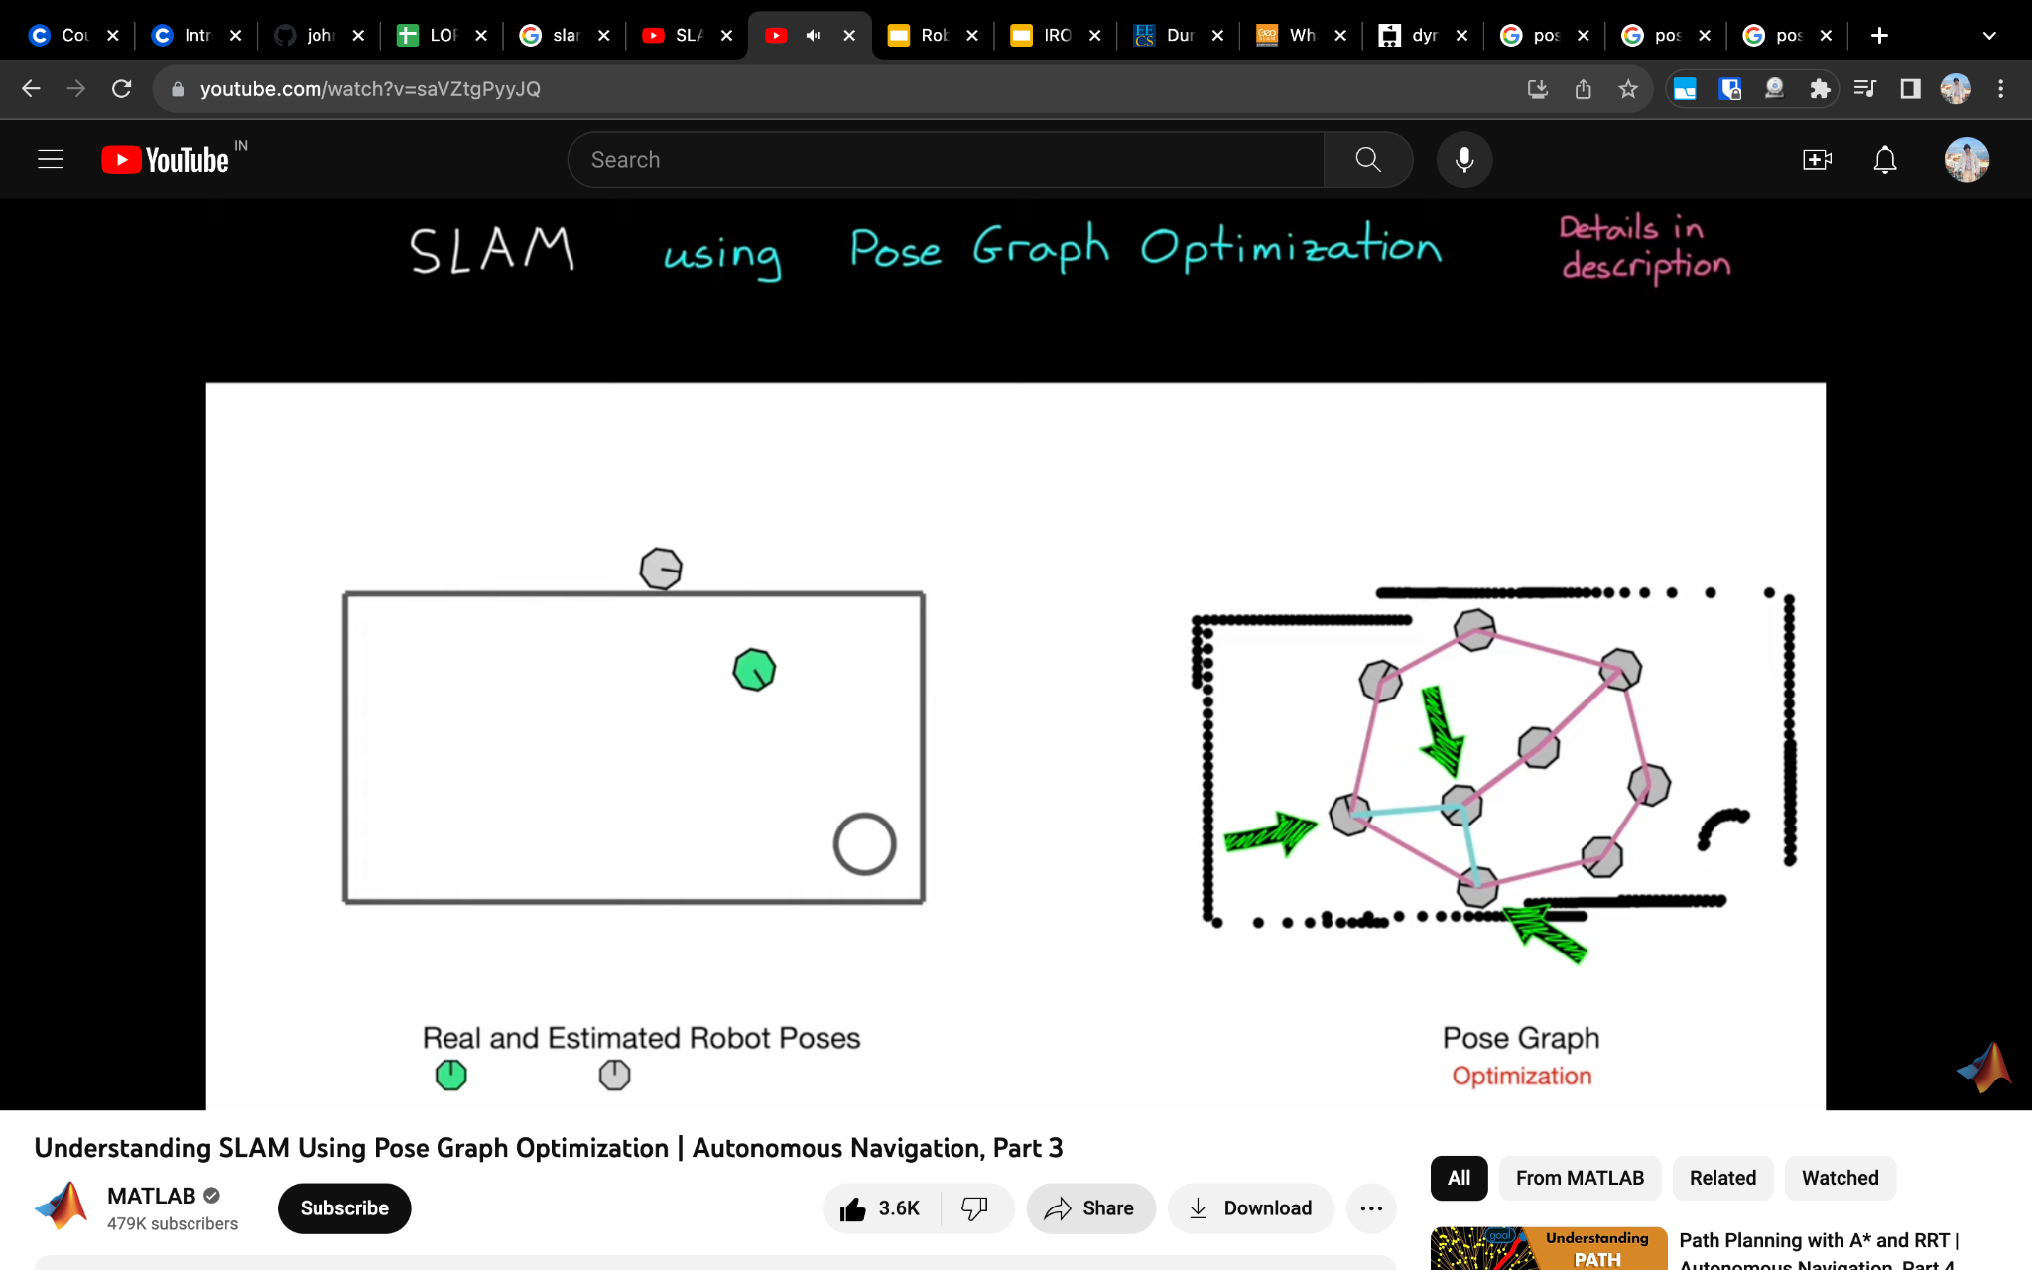
SLAM
Pose Graph Optimisation
Notes:
Each point in the pose graph is connected by what can be considered as a string attaching them which is based on how much confidence we have on how far we have moved.
Now our objective is that once we find a point that we recognise as having seen before, we close the loop. This can be understood as pulling these strings which have tension in them such that they are now aligned.

Slide 8
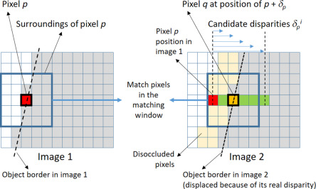
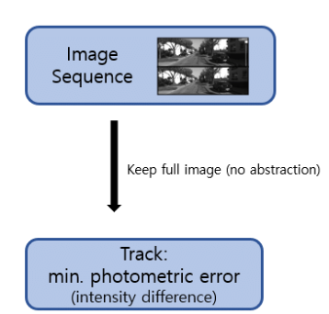
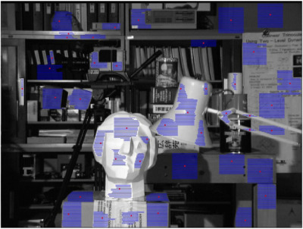
Visual SLAM - Feature Based vs Direct
FEATURE BASED METHODS Computationally expensive, inaccurate in repetitive textures Source: google | DIRECT METHODS higher accuracy and robustness, especially in poorly-textured (less-textured or repetitively-textured) optimizes a photometric error Source: google
Notes:
Feature based methods detect and match features across frames.
They estimate the relative camera motion by minimizing the reprojection error. Matching is done using methods like Local Stereo Matching or Epipolar Geometry. The image shows matching pixels in the windows in stereo matching.
Direct methods skip the pre-processing step and directly use the actual sensor values – light received from a certain direction over a certain time period. The direct approach thus optimizes a photometric error, since the sensor provides photometric measurements.

Slide 9
Problem Statement
Proposed a novel SLAM algorithm that is:
Fast i.e Computationally efficient - Independent of feature detection and stereo matching
Accurate and robust
Imitates a LiDAR scan - adapt a LiDAR descriptor for place recognition
Uses stereo system for simplicity and accessibility

Slide 10
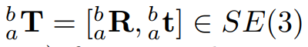
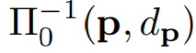
Algorithm Overview: Notations
Transformation (Rotation and translation) from coordinate a to coordinate b
Stereo Camera = Cam0 and Cam1. For Camk where k ∈ {0, 1}
Image is I_{k} and the camera projection is denoted as Π_{k}
3D point is represented by
where p = pixel coordinates and dp = (inverse) depth which are back-projected into 3D space

Slide 11
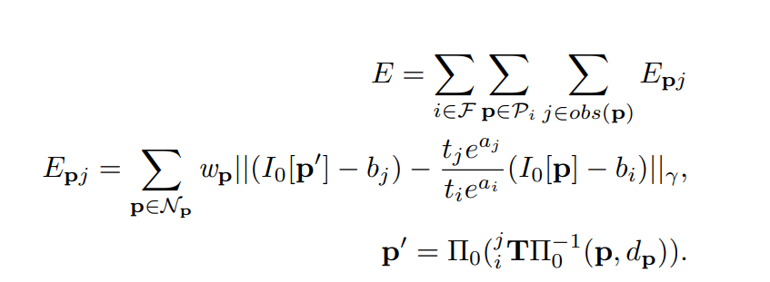
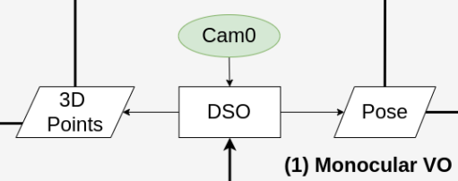
Algorithm Overview: Monocular VO -
E_{pj} = associated photometric error
affine brightness terms (a_{i/j} , b_{i/j} ), exposure times t_{i/j} , pixel pattern N_{p}, weight wp, and Huber norm || · ||_{γ} are included for photometric robustness
Notes:
VISUAL ODOMETRY Uses camera feed to figure out how you are moving through space
From camera frame to camera frame = looks at key points in the frame to see if moved forward, backward etc
DSO stands for DIRECT Sparse odometry which uses non-linear optimization framework to optimize the photometric error defined directly on the images, without incorporating a geometric prior, Sparse methods use and reconstruct only a selected set of independent points.
P’ is the camera 1 projection of the transformed pixel coordinates and depth from frame i to j frame
Epj defined in Eq. 2 is the pixel intensity difference between a point p in keyframe i and its projection p’ in keyframe j

Slide 12
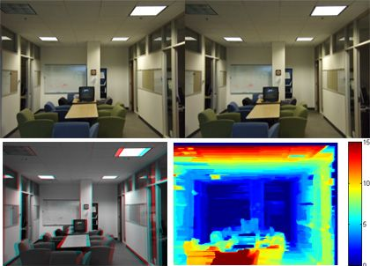
Algorithm Overview: Scale Optimization
Notes:
Imagine seeing the world with one eye closed, we cannot judge the distance to the objects around us. Similarly, we need some way to infer scale of objects for monocular vision. Using stereo system can allow us to match points between the two images and infer their distance. But, this method does not work well for textured environment, where features are similar at multiple points in the image. The main idea of the method that this paper uses is to projecting the points from monocular VO on Cam0 to Cam1 and find the optimal scale that minimizes the photometric error defined as:

Slide 13
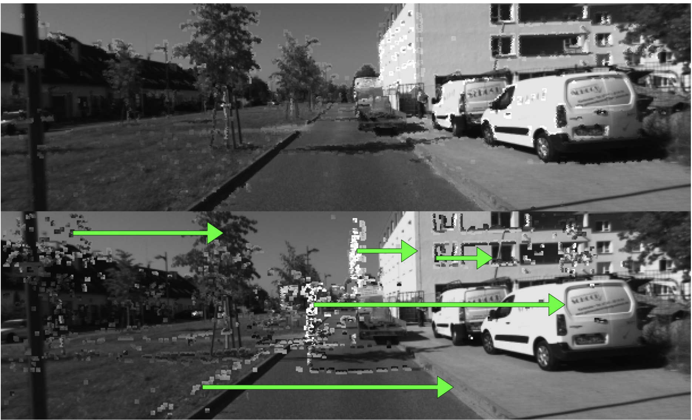
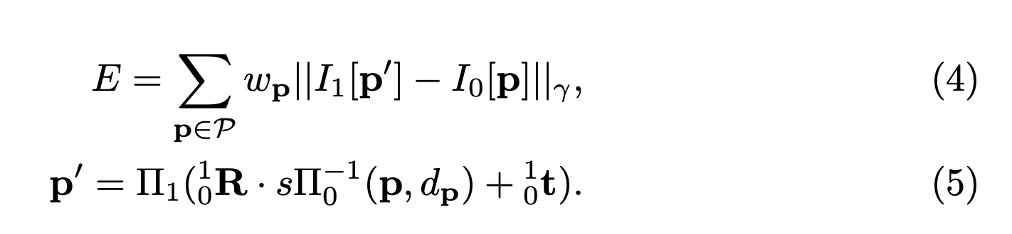
Algorithm Overview: Scale Optimization
Image space
3D Point
Projection matrix
scale
Notes:
Imagine seeing the world with one eye closed, we cannot judge the distance to the objects around us. Similarly, we need some way to infer scale of objects for monocular vision. Using stereo system allows us to match points between the two images and infer their distance. But, this method does not work well for textured environment, where features are similar at multiple points in the image. Therefore, the main idea of the method that this paper uses is to projecting the points from monocular VO on Cam0 to Cam1 and find the optimal scale that minimizes the photometric error defined as:

Slide 14
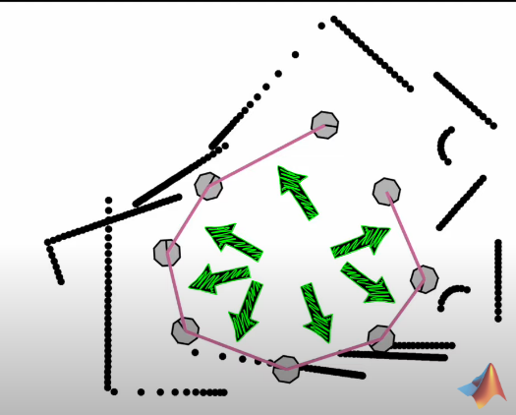
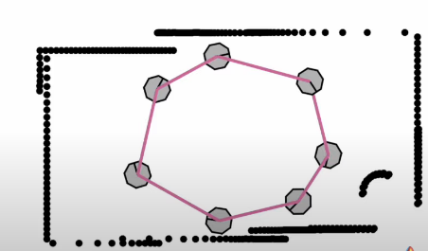
Loop Closure:

Slide 15
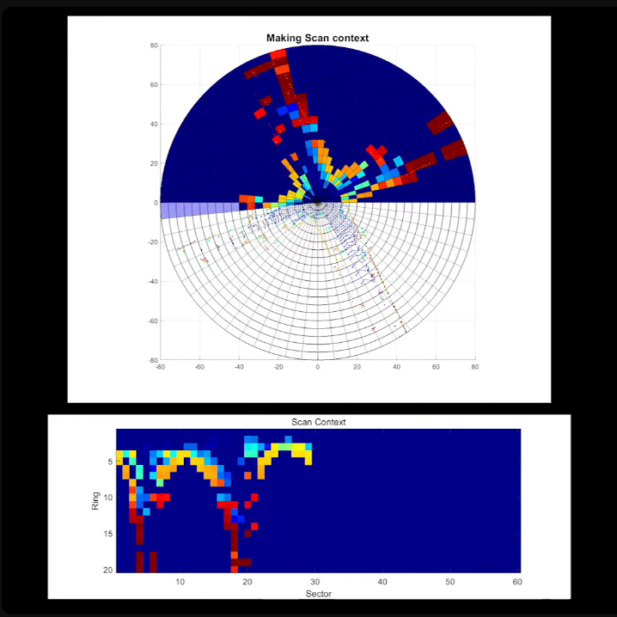
Algorithm Overview: Loop Detection using Scan Context

Slide 16
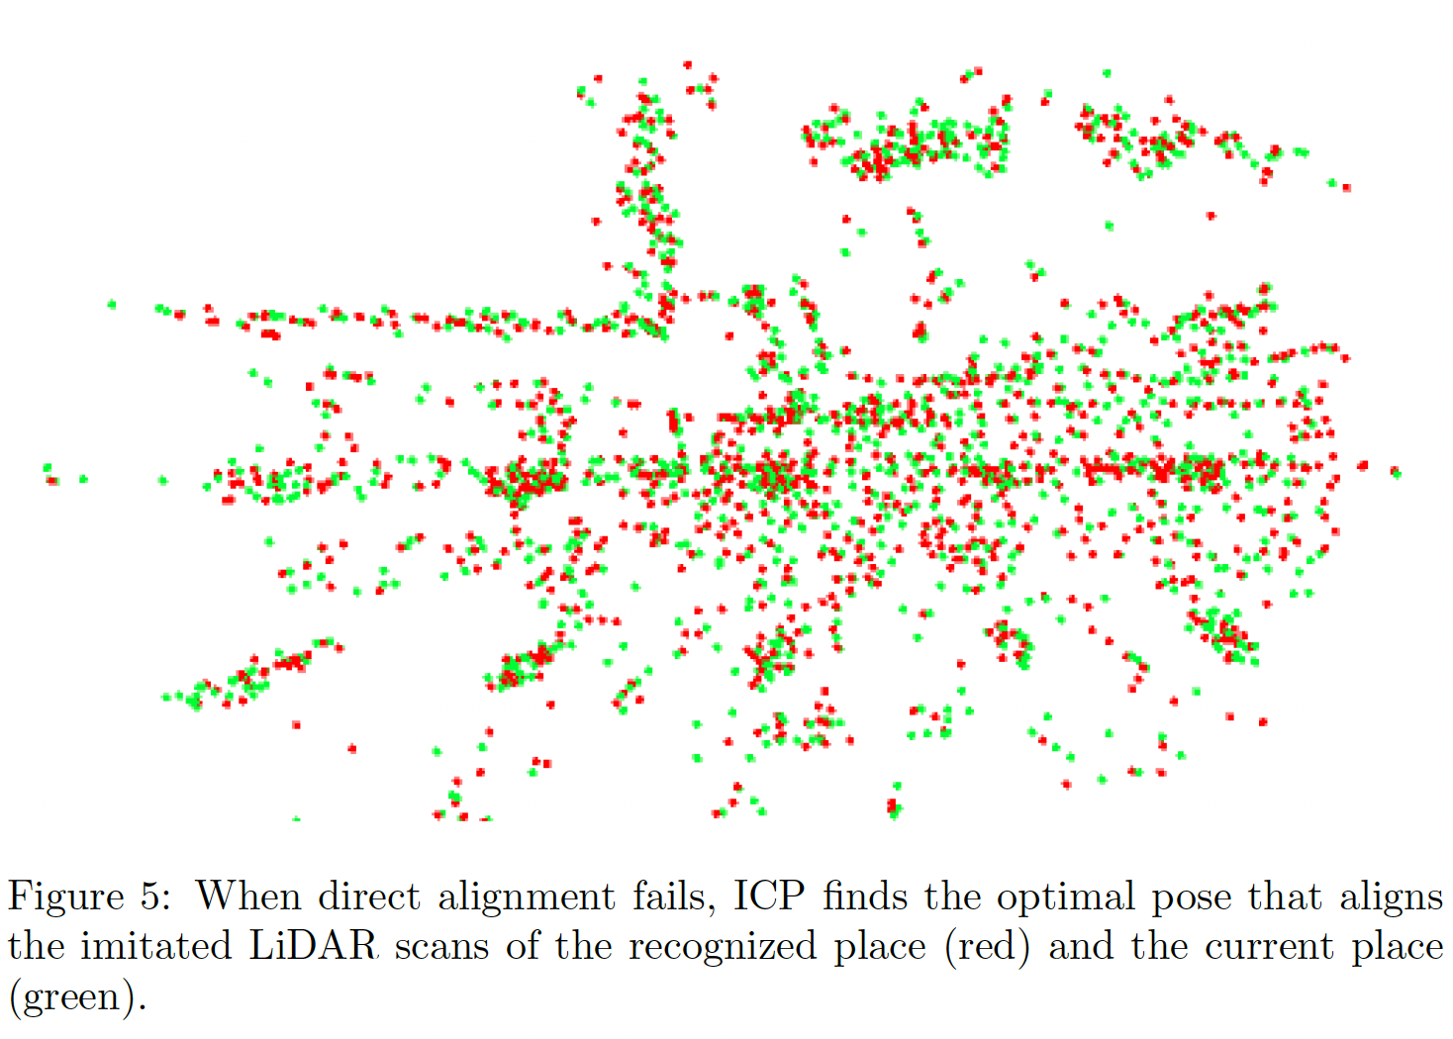
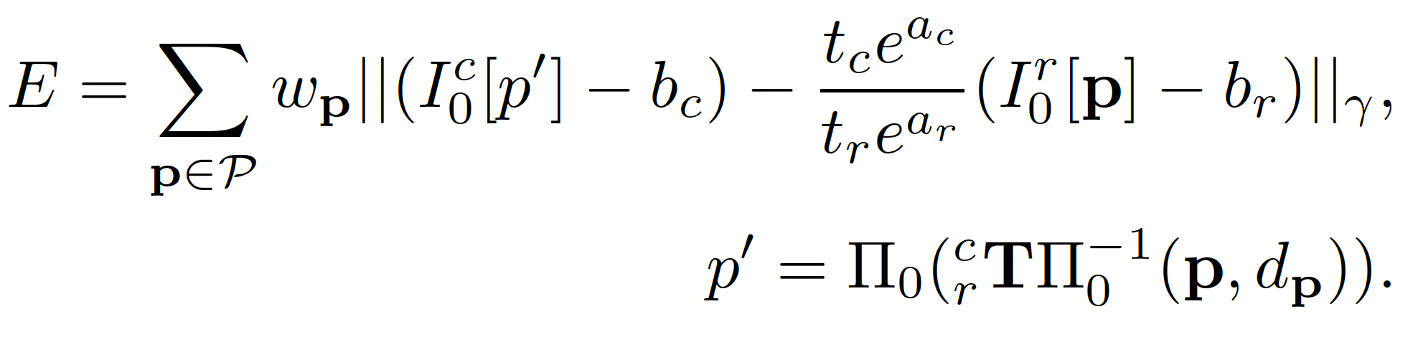
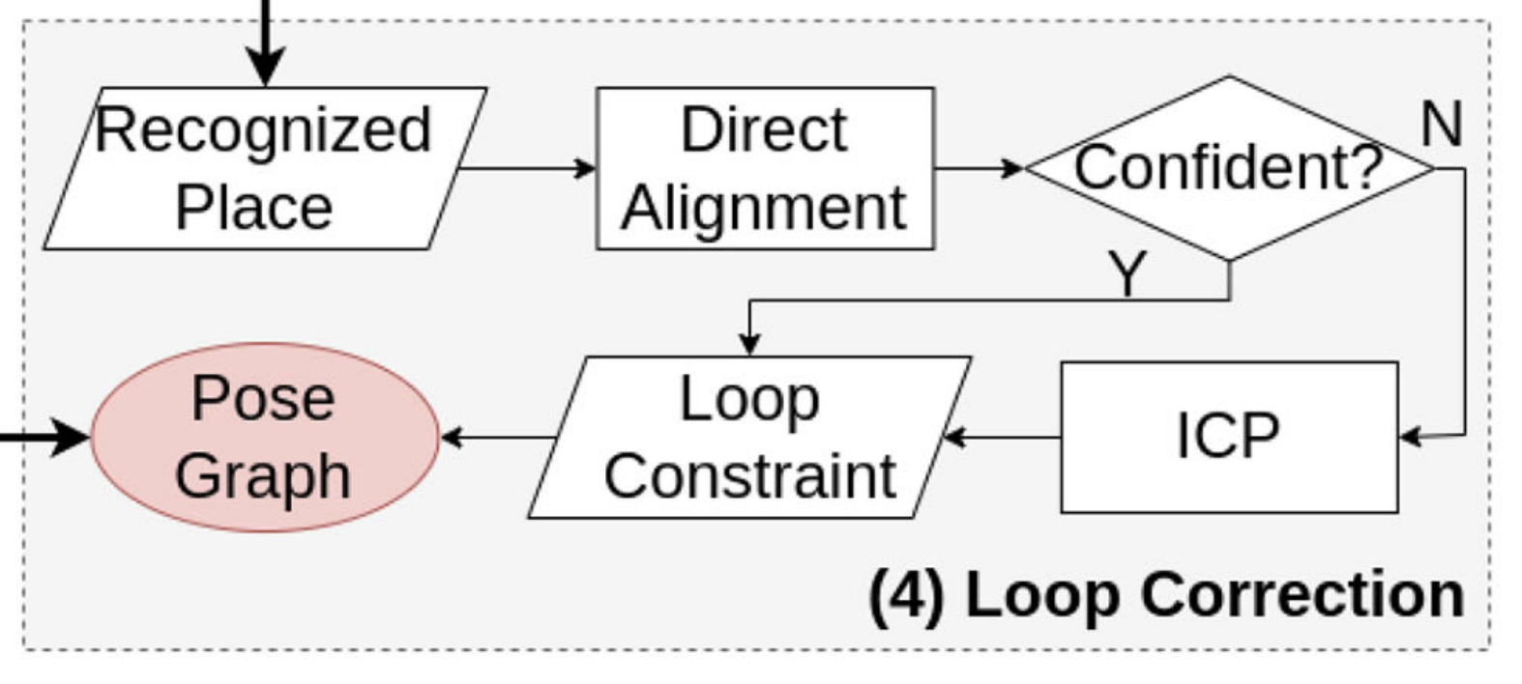
Algorithm Overview: Relative Pose Estimation

Slide 17
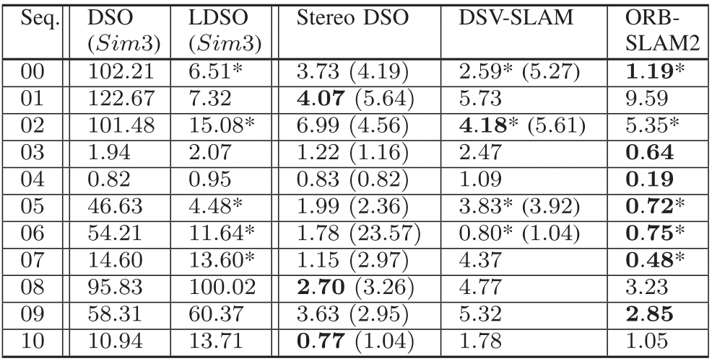
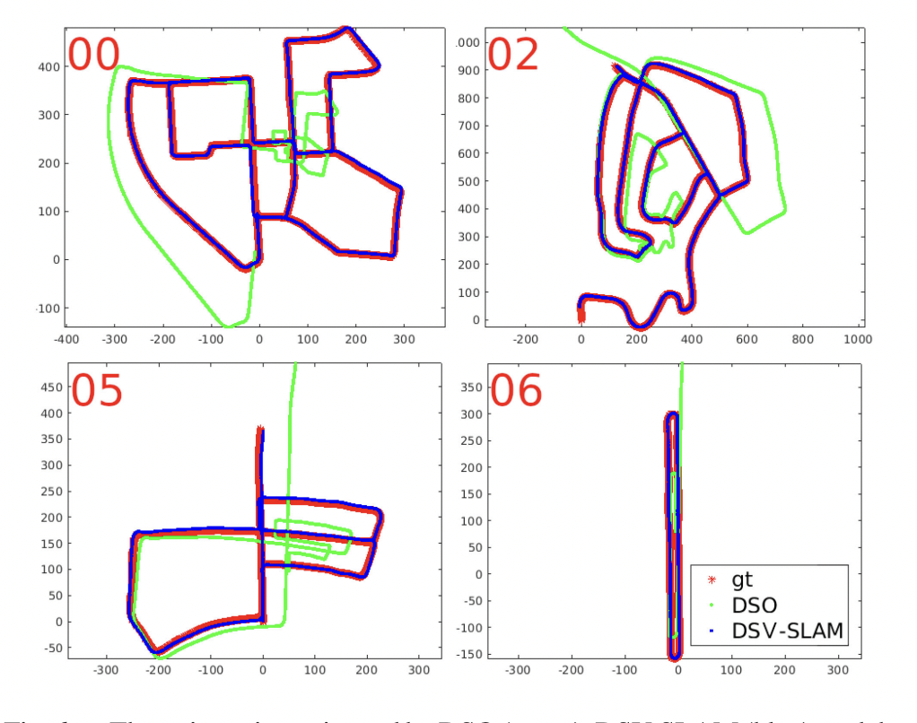
Paper Results:
Evaluation on KITTI Dataset
Comparison of different methods for localization and mapping techniques like Direct Sparse Odometry (DSO), LiDAR based DSO (LDSO), Stereo DSO and ORB-SLAM2 with proposed DSV-SLAM are done on 11 sequences from the dataset.
Table comparing Absolute Trajectory Error (in m) for implementations of SLAM methods
Figure shows the trajectories estimated by DSO, DSV-SLAM and the ground truth
Notes:
KITTI is a dataset is one of the most popular datasets for use in mobile robotics and autonomous driving. It consists of hours of traffic scenarios recorded with a variety of sensor modalities, including high-resolution RGB, grayscale stereo cameras, and a 3D laser scanner.
With DSO being monocular VO, its ATEs are large due to the drifting scale
For many sequences the results attained by Stereo DSO and DSV-SLAM are comparable but not as good as ORB-SLAM2 as it has more comprehensive system design.
Since our stereo VO with scale optimization is already very accurate, the improvement with loop closure is not as drastic as LDSO over DSO.
However, unlike LDSO and ORB-SLAM2, DSV-SLAM does not capture the loop closure in sequence 07.
This is because the overlapped trajectory is too short to accumulate Local Points and imitate LiDAR scans for place recognition, whereas BoW works on a single frame.

Slide 18
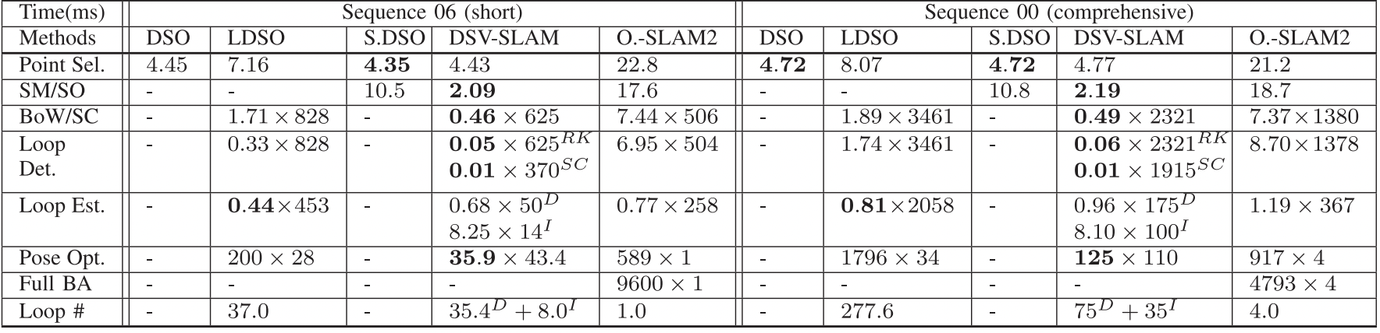
Paper Results:
Evaluation on KITTI Dataset
The strength of DSV-SLAM lies not in it’s accuracy based on trajectory error, but it’s superiority based on Computational efficiency
This can be seen from the given table showcasing run-time comparisons on short and comprehensive sequences among different SLAM methods.
Notes:
the point selection , scale optimization (SO) in DSV-SLAM is much faster than the stereo matching (SM) in Stereo DSO and ORB-SLAM2.
ORBSLAM2 complex mechanisms to improve accuracy and robustness. Hence these complicated conservative approaches incur considerable computational overhead
We can see that DSV-SLAM is more efficient in different methods of localization and mapping on different types of sequences as well. ORB-SLAM2 uses feature descriptors for stereo match which is one of the slowest. To improve accuracy, ORB-SLAM2 uses various complex mechanisms which reduce efficiency.

Slide 19
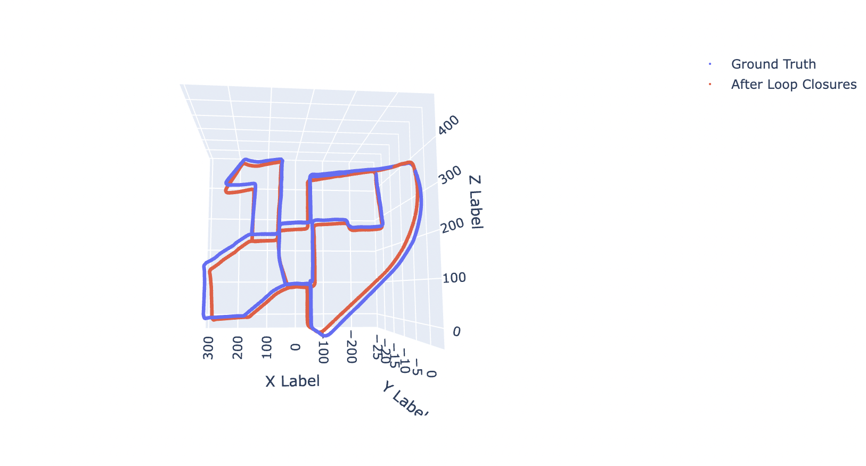
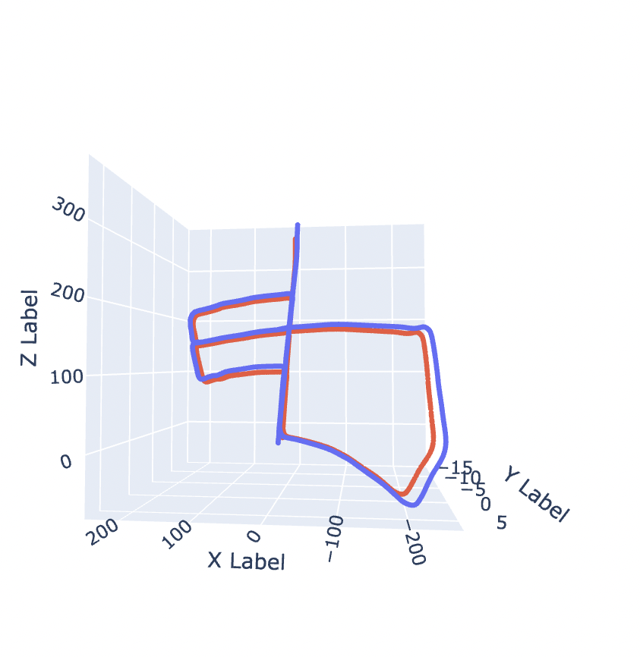
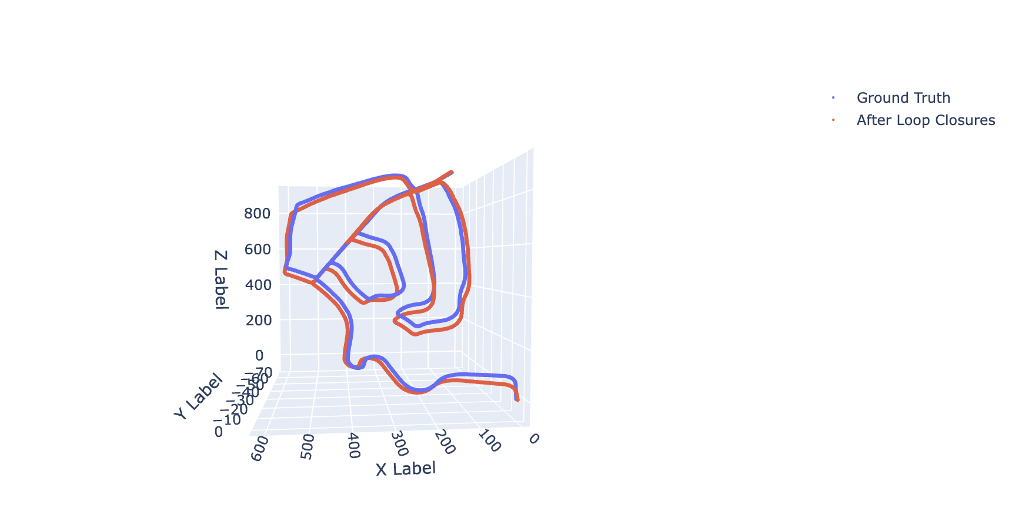

Our Results
Sequence 00
Sequence 02
Sequence 05
Seq | Absolute Trajectory Error on DSV SLAM (in m)
00 | 9.626983136888907
02 | 5.43533827271844
05 | 5.915274162637337

Slide 20

Demo

Slide 21
Summary and Conclusion
With this project our aim was to understand the working of SLAM algorithms.
We were able to reproduce the Direct Stereo SLAM algorithm which is an efficient visual SLAM algorithm and able to get results comparable to the authors.
In the future we would want to expand this work by having it work on live feed.
We have also worked to identify the working challenges of the available code of the paper, and wish to contribute our steps to make it work.

